Slide 1
Progress Reports for Research & Projects
Nik Bear Brown
nik@ccs.neu.edu

Slide 2
Progress Report
An account of how much work has been done on something and what still needs to be done
An assessment that conveys details such as what sub-goals have been accomplished, what problems have been encountered, and whether the project is expected to be completed on time.
- http://www.businessdictionary.com/definition/progress-report.html

Slide 3
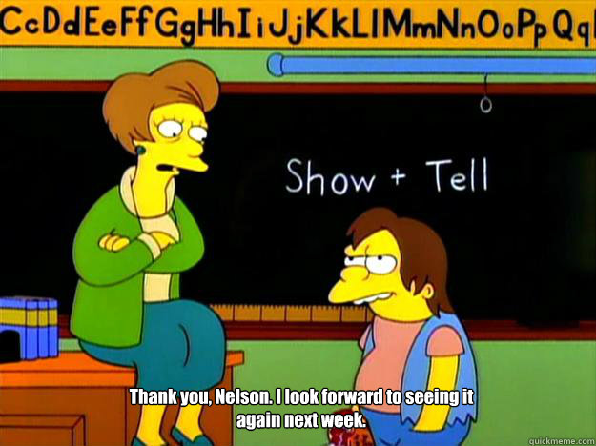

Slide 4
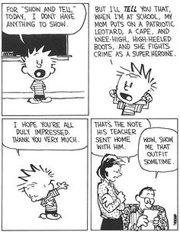

Slide 5
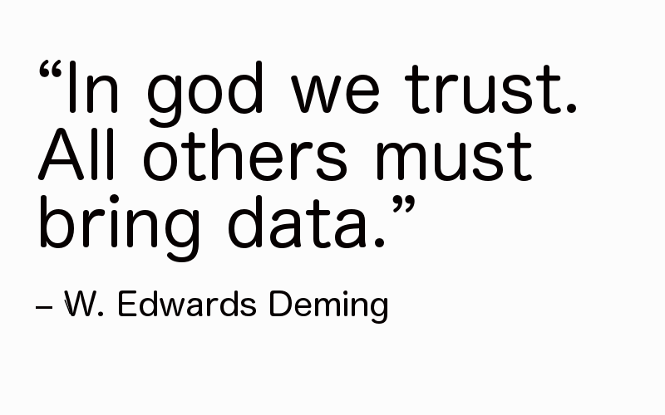

Slide 6
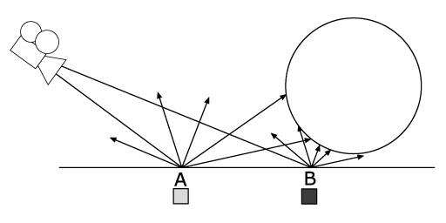
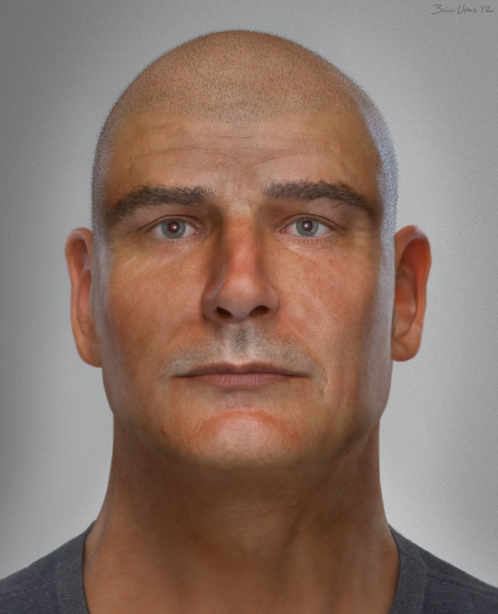

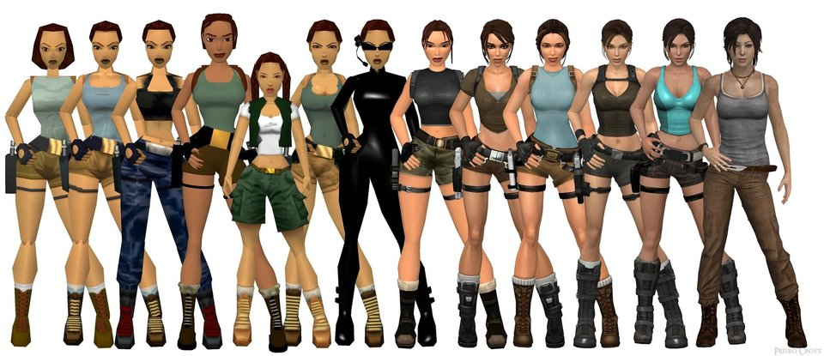
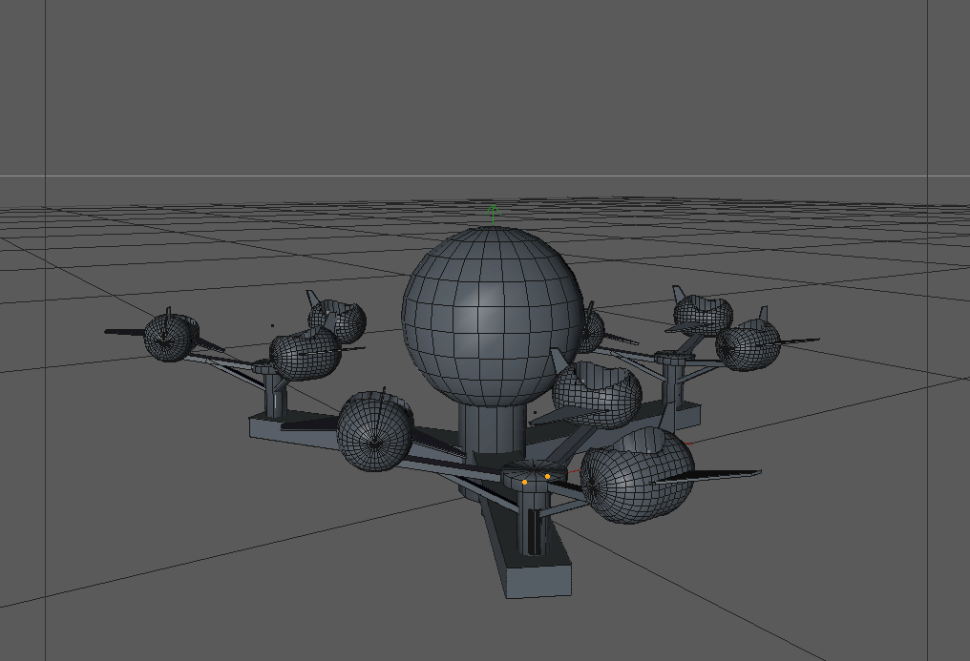
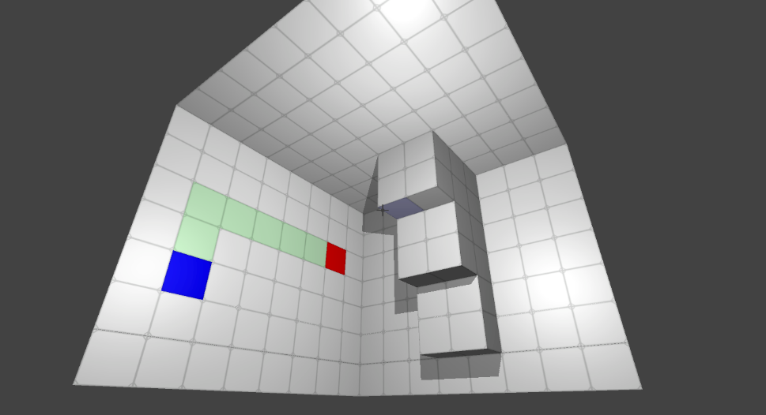

Example Student Progress Reports & Projects

Slide 7
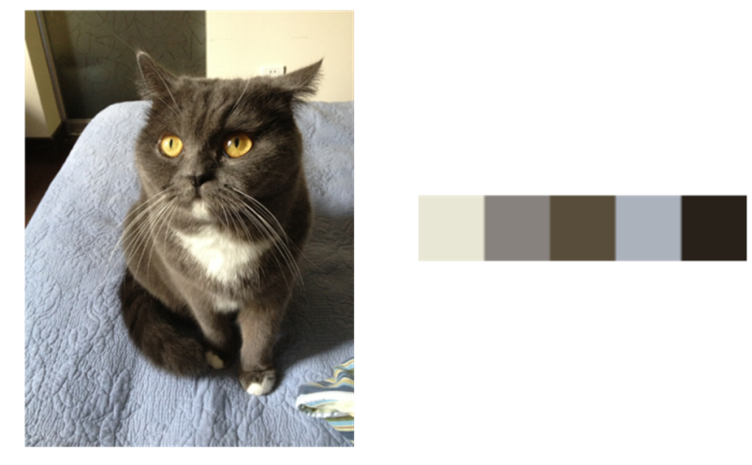
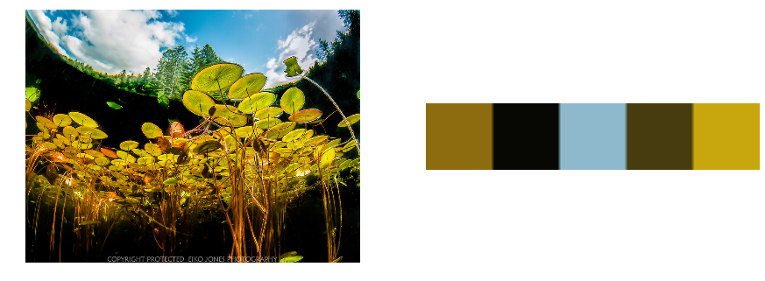
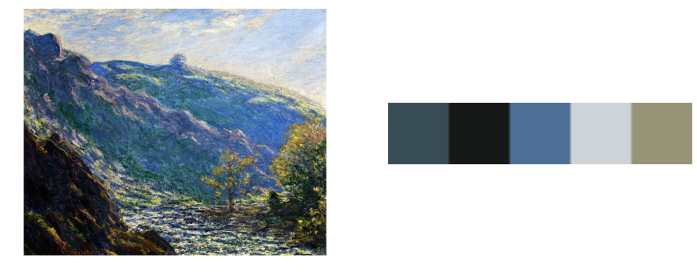


Detecting Dominant Colors In Images
Detecting dominant colors in images

Slide 8
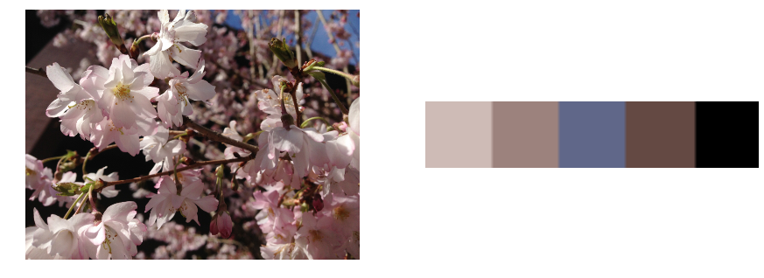
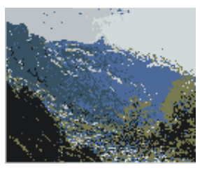
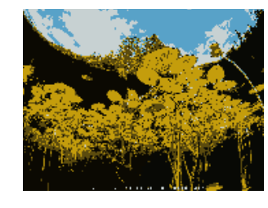
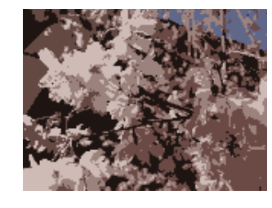
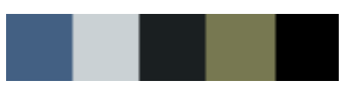
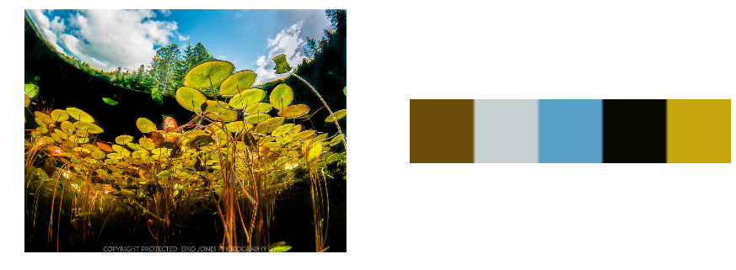
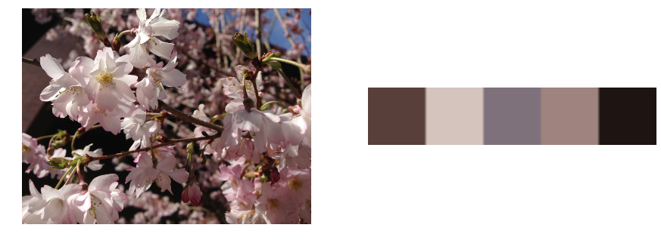
Method – Averaging Color
Segmentation first
Then compute the average color in each segmentation

Slide 9
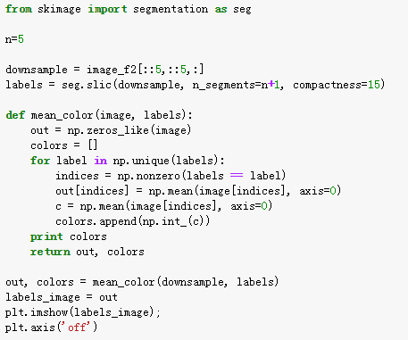
Method – Averaging Color
Code

Slide 10
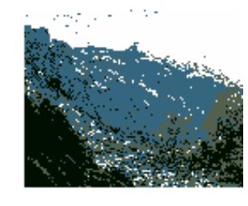
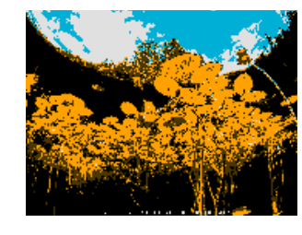
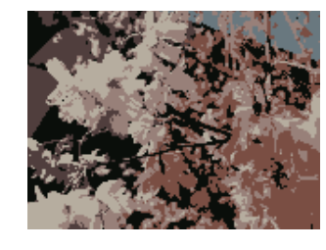
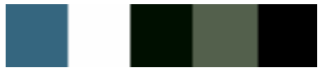
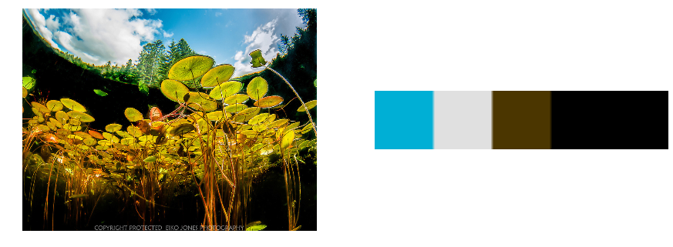
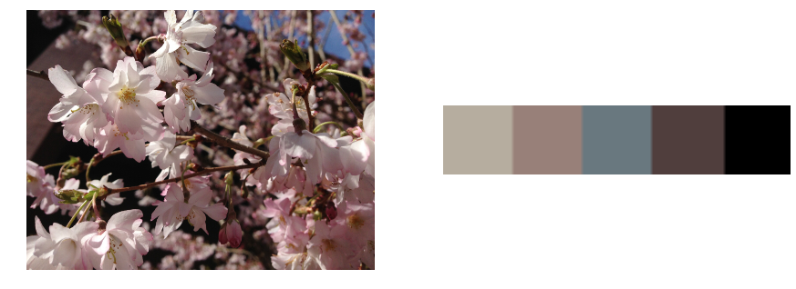
Method – High Frequency Color
Segmentation first
Then pick out the color with highest frequency in each segmentation

Slide 11
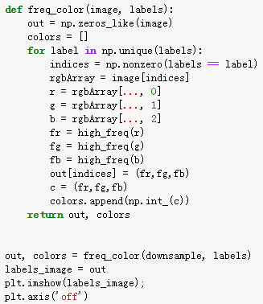
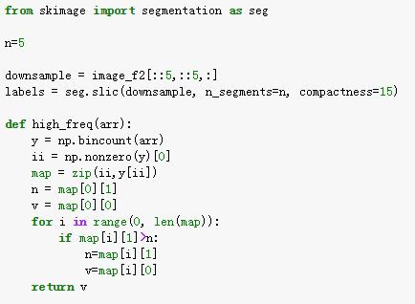
Method – High Frequency Color
Code

Slide 12
Method – K-Means
Initialize the k cluster center (randomly)
Assigning the objects to the nearest cluster center
Compute the centroid of each k cluster
Re-estimate the k cluster centers to the centroid
Repeat the step 2-4 until the distance of new cluster centers and old cluster centers are very small

Slide 13
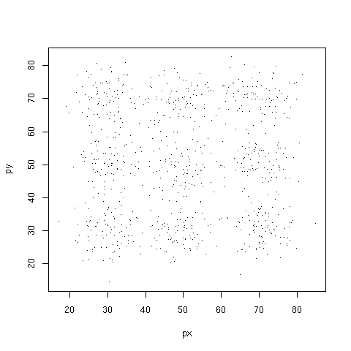
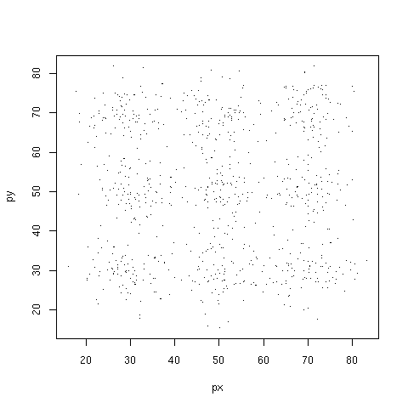
Method – K-Means
Simulation of K-Means in two dimensional space:
Good Result
Poor Result

Slide 14
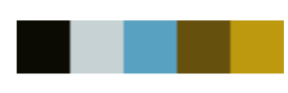
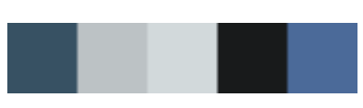
Method – K-Means
Unstable
Unable to handle noisy data and outliers

Slide 15
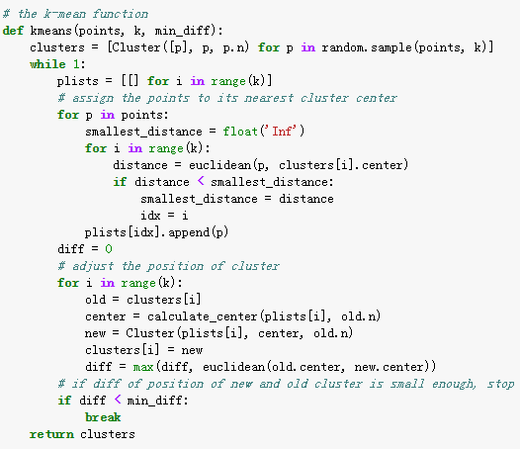
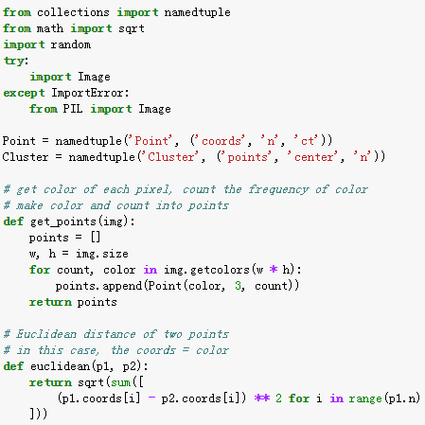
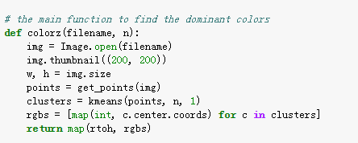
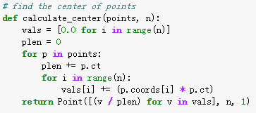
Method – K-Means

